Slide 1
Energy Conservation & Management

Slide 2
Contents
Introduction
Forms of Energy
Classification of Energy
Primary or Secondary Source of Energy
Commercial and Non-commercial Energy Sources
Renewable and Non-Renewable Energy Sources
Conventional and Non-conventional Energy Sources
Energy Conservation
Energy Conservation Act 2001 & its Features
Schemes of Bureau of Energy Efficiency (BEE)
Electricity Act & its Features

Slide 3
INTRODUCTION
Energy is defined as the ability or capacity to do any work.
According to the law of conservation of energy states that energy can neither be created nor it can be destroyed, it can only be converted from one form to another.
Energy exists in several form such as heat, kinetic or mechanical energy, light energy, potential energy, electrical or other forms.
Example:
In a room heater, electrical energy is converted to thermal energy.
Turbine converts mechanical energy stored in steam to electrical energy.

Slide 4
Common forms of Energy
Thermal Energy (TE):
Thermal energy is used for various industrial and domestic requirements. TE can be converted to mechanical energy by using heat engine.
High Temperature (500-1000ºC higher): TE can be converted efficiently into mechanical energy.
Medium Temperature (150-500ºC): TE can be converted into mechanical energy with difficulty.
Low Temperature (80-150ºC): TE cannot be converted efficiently into mechanical energy used mostly for heating.

Slide 5
Chemical Energy (CE):
Fuels and organic matter contain chemical energy.
Exothermic chemical reactions release heat energy.
Directly converted into electrical energy in fuel cells.
Converted into thermal energy by combustion.
Mechanical Energy (ME):
Movement of objects
Changing the shape of the objects
Used in transportation, agricultural. handling, processing etc.

Slide 6
Electrical Energy:
High grade energy
More than 40 % energy distribution is met through electrical supply systems.
Very conveniently and efficiently converted to other forms of energy.

Slide 7
Classification of Energy
Primary and Secondary source of energy
Energy
Conventional and non-conventional source of energy
Renewable and non-renewable source of energy
Commercial and non-commercial source
Low grade energy and high grade energy

Slide 8
Primary or Secondary Source of Energy
Primary source of energy
Primary sources can be used directly, as they appear in the natural environment. Such kind of sources has not undergone any transformation or conversion other than separating and cleaning.
Thus the primary energy sources are those that are either found or stored in nature.
Primary energy sources are mostly converted in industrial utilities into secondary energy sources.
Ex. Coal, oil or gas converted into steam and electricity but primary energy sources can also be used directly e.g coal used for cooking.

Slide 9
Secondary Source of Energy
Secondary sources derive from the transformation of primary energy sources.
for example petrol, that derives from the treatment of crude oil and electric energy, obtained from the conversion of mechanical energy, chemical plants , or nuclear plants.
Electric energy is produced by electric plants, i.e. suitable installations that can transform primary energy (non transformed) into electric energy.

Slide 10
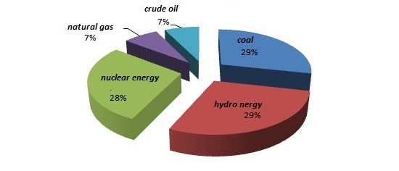
Conventional energy and non-conventional energy
Conventional energy
Conventional sources of energy is, “Energy sources which cannot be compensated once they are used”.
Fossil fuels are major sources of conventional energy. They cannot be replenished once they are consumed.
The coal, petroleum, natural gas and electricity are conventional sources of energy.

Slide 11
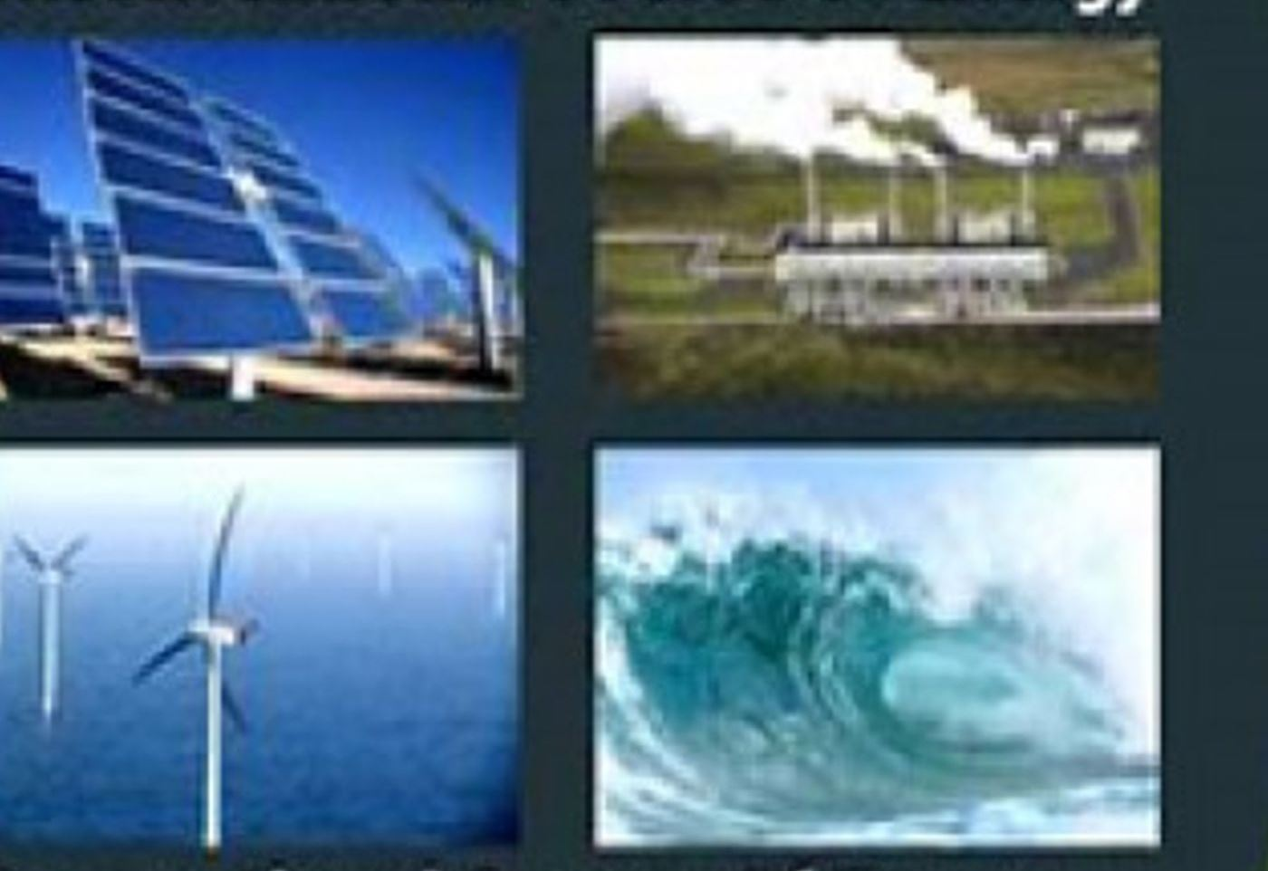
Non-conventional source of energy
The energy resources which are inexhaustible are called as non conventional energy source.
Energy generated by using wind, tides, solar, geothermal heat, and biomass including farm and animal waste is known as non-conventional energy.
All these sources are renewable or inexhaustible and do not cause environmental pollution and are ecofriendly.

Slide 12
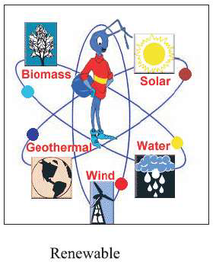
Renewable Energy Sources
This is the energy acquired from never ending sources of energy available in nature. The main feature of this is, it can be extracted without causing pollution.
Renewable energy is energy that is collected from renewable resources, which are naturally replenished on a human timescale, such as sunlight, wind, rain, tides, waves, and geothermal heat. Renewable energy often provides energy in four important areas: electricity generation, air and water heating/cooling, transportation, and rural (off-grid) energy services.
Example: Solar energy, wind energy, tidal energy

Slide 13
Renewable Energy:
Renewable energy can be generated continuously practically without decay of source.
Example:
Solar
Wind
Geothermal
Hydro
Biomass
Tidal

Slide 14
Solar Energy
Solar energy can be converted into electrical energy by using solar panels.
Solar power electrical generation depends on heat engines and photovoltaic’s.
Example:
Solar cooker
Solar heater
Solar cells
Advantages:
Solar energy doesn’t produce carbon dioxide
It have minimal impact on environment
Disadvantages:
It is not constant, it depends on weather conditions, time and location.

Slide 15
Wind Energy
Wind energy generated by wind turbines is mainly used to generate electricity.
Advantages:
Wind turbines (often called windmills) do not release emissions that pollute the air or water.
Disadvantages:
Installation and maintenance cost is very high
Only few places are there in world where wind blow contiously throughout the year.

Slide 16
Geothermal Energy
Geothermal Energy is heat from within the earth. We can recover this heat as steam or hot water and use it to heat buildings or generate electricity.
Examples:
Hot springs
Fumaroles (smoke)
Geysers
Advantages:
Carbon dioxide emission levels are very low. They release less than 1% of the carbon dioxide.
Disadvantages:
Installation cost is very high.
Release various kind of harmful gases.

Slide 17
Hydro Energy
Hydro energy is generally generated from running water using various mechanical methods.
Examples:
Dam
Tidal Barrages
Ocean Thermal Energy Conversion system
Advantages:
Produces very less amount of carbon diaoxide
It is also being used to control flood and for irrigation purposes.
Disadvantages:
Natural environment is destroyed.

Slide 18
Biomass Energy
Biomass is organic material made from plants and animals waste.
(Microorganisms)
When it is burned, the chemical energy in biomass is released as heat.
Examples:
Methanol
Ethanol
Biodiesel
Advantages:
Equipment (Biogas Plant) installation cost is less
Help is garbage reduction
Disadvantages:
Release high amount of sulphurous gases.

Slide 19
Tidal Energy
The energy contained in ocean waves can potentially provide an unlimited source of renewable energy.
Ocean waves are created by the interaction of wind with the surface of the sea.
Advantages:
It doesn’t produce greenhouse and its life is very long.
It’s efficiency is around 80%. It doesn’t require any kind of fuel to run.
Disadvantages:
Cost of construction of tidal power plant is high.

Slide 20
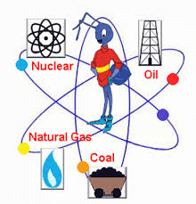
Non-renewable source of energy
Non renewable energy can’t be generated again and again from the same source.
A non-renewable resource (also called a finite resource) is a resource that does not renew itself at a sufficient rate for sustainable economic extraction in meaningful human time-frames.
Example:
Petrolium products (kerocine, petrol, diesel, etc.
Coal
Uranium

Slide 21
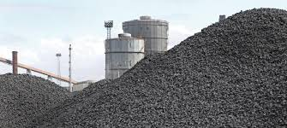
Coal:
Coal is combustible black or brownish black sedimentary rock composed mostly of carbon and hydrocarbons.
The heat and pressure from the top layers helped the plant remains turn into what we today call coal.

Slide 22
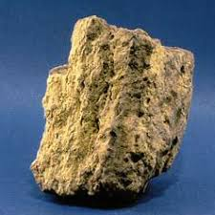
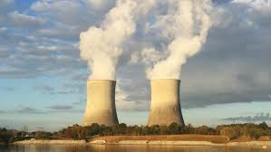
Uranium
Nuclear energy is energy in the nucleus of an uranium 235. Atoms are tiny particles that make up every object of in the universe.
It can be released from atoms in two ways:
Nuclear fusion
Nuclear fission
Advantages:
Even a small amount can release enough energy to light-up thousand of energy for months. (1kg uranium-235 corresponds to 2.7 million kg coal equivalent.
Disadvantages:
After using it in nuclear reactor then also it radioactive substances is vey dangerous for human.
Ex: Carbonyl accident and Fujushima paln accident.

Slide 23
Commercial and Non-commercial sources
Commercial Energy
The energy sources that are available in the market for a definite price are known as commercial energy.
Commercial energy forms the basis of industrial, agriculture, transport and commercial development in the modern world.
In the industrialized countries, commercialized fuels are predominant source not only for economic production, but also for many households tasks of general population.
Examples: Electricity, coal, oil, natural gas, etc.

Slide 24
Non-commercial energy
The energy sources that are not available in the commercial market for a price are classified as non-commercial energy.
Non-Commercial energy sources include fuels such as fire wood and agricultural wastes, which are traditionally gathered, and not bought at a price used especially in rural households. These are also called traditionally fuels.
Non-Commercial energy is often ignored in every accounting.
Example:
Firewood, agro waste in rural areas;
solar energy for water heating, electricity generation, for drying gain, fish and fruits;
animal power for transport, threshing, lifting water for irrigation, crushing sugarcane;
wind energy for lifting water and electricity generation.

Slide 25
Low grade energy & High grade energy
Low grade energy
Energy of which only a certain portion can be converted into mechanical work is called low grade energy.
Thus it is not possible to convert energy source easily and completely into another form of energy.
For example coal is low grade energy as its only 30% can be converted into electricity with requirement of huge setups.
It is available at cheaper rate.
Other Examples of Low grade energy are:
Heat or Thermal Energy
Heat derived from combustion of fossil fuels
Heat derived from nuclear fission or fusion.

Slide 26
High Grade Energy
Energy that can be completely transformed or converted into work or other forms of energy without any loss i.e. fully utilizable. Are called as high grade energy
For example. Electrical energy because it is very easy to convert almost all of it into other form by using an electrical heater,mobile battery charging,A.C.,etc
High grade energy are expensive
Other Examples of high grade energy are:
1. Mechanical work
2. Water Power
3. Wind Power
4. Tidal Power

Slide 27
Differences Between Renewable and Non-Renewable Source of Energy
Renewable Sources | Non-Renewable Sources
Renewable energy can be generated continuously practically without decay of source. | Non-renewable can’t be generated continuously without decay of source.
Responsible for 3-4% of carbon dioxide is environment. | Responsible for 91-94% of carbon-dioxide is environment.
Not a reason behind “global warming”. | Main reason behind “global warming”.

Slide 28
Energy Conservation
Energy conservation refers to efforts made to reduce energy consumption.
Energy conservation can be achieved through increased efficient energy use or reduced consumption from non-renewable energy sources.
Energy conservation is often the most economical solution to energy shortages.

Slide 29
Why to Conserve?
We have limited fuels available on earth.
Our demand for energy is increasing day by day.
It is possible that someday, most of fuels will be exhausted, and we will have to switch to alternate energy.

Slide 30
Conservation of Energy at Various level
Energy conservation at household level
Energy Conservation at community level
Energy conservation in industry and other places
Energy conservation in transportation sector

Slide 31
Energy conservation at household levels:
Energy conservation in major appliances for domestic use:
Energy conservation in refrigerator
Energy conservation in microwave oven
Energy conservation in ironing
Energy conservation in cooking
Energy conservation in washing machine
Energy conservation during lighting
Energy conservation during cooling

Slide 32
Energy conservation at community level
All necessary light should be turned off especially when conference room etc. are not in use.
Computer, Monitor and other business equipment should be set to their in energy saving mode.
Skylights should be used for warehouses.
We should ensure that offices having air conditions have proper windows and all doors are closed when the air conditioner is in use.

Slide 33
Energy conservation in industry and other places
Auditing
Process Modification
Improved measuring instruments
Energy loss reduction
Light load reduction

Slide 34
Energy conservation in Transportation Sector:
Reduction of Fuel Consumption
Car speed should be maintained as far as possible 50 to 60 km/hour.
We should avoid free frequent starts and stops to reduce fuel consumption
We should apply breaks gradually as far as possible
Fuel Economy – Maximizing Behaviour
Moderating Driving
Driving at lower speeds
Turning off a vehicles engine at stops rather than idling & using cruise control

Slide 35
Energy Conservation in India
In India, government has passed “energy conservation bill, 2001” for better utilization of energy and conservation of the same.
By this act, it is mandatory for energy intensive sectors to get their “energy audit” conducted by energy auditor.
Bureau of Energy Efficiency: This body keeps watch on energy consumption patterns, develops norm for appliances etc.
Star ratings: BEE has also initiated “star rating system” for electrical appliances e.g. CFL’s, geysers, refrigerators, etc.

Slide 36
Data Related to Energy Consumption in India
About of 70% India's energy generation capacity is from fossil fuels, with coal accounting for 40% of India's total energy consumption followed by crude oil and natural gas at 24% and 6% respectively.
By 2030 India's dependence on energy imports is expected to exceed 53% of the country’s total energy consumption. In 2009-10 the country imported 159.26 million tones of crude oil which amount to 80% of its domestic crude oil consumption.
In India 31% of the country’s total imports are oil imports.

Slide 37
What we can do?
Always switch off light and fans while going out of room.
We should not open fridge frequently.
While going to purchase new products. ex. Geyser’s, television, CFL etc. insist foe rating ranging from 4-5.
Increase everyone’s understanding of the benefits of energy efficiency.

Slide 38
What we can do?
Recycle waste material into new products to prevent waste of potentially useful materials.
Replace old light bulbs with energy saving fluorescent bulbs.
They may cost more, but will save you much more in the long run.

Slide 39
Energy Conservation Act 2001 & its features
Enacted on 1st October 2001.
Become effective from 1st March 2002.
Objective of providing necessary legal framework for promoting energy conservation measures in the country.
Bureau of Energy Efficiency(BEE) operationalized from 1st March 2002.

Slide 40
Purpose of the Energy Conservation Act -2001
The purpose of this act is to provide for efficient use of energy and its conservation.
Provide a policy framework and direction to national energy conservation activities.
Coordinate policies and programs on efficient use of energy with stakeholders.
Stablish systems and procedures to verify measure and monitor EE improvements.
Leverage multilateral, bilateral and private sector support to implement the EC Act.
To promote energy efficiency in the country.

Slide 41
Important Features of Energy Conservation Act-2001
Energy Conservation Building Code (ECBC)
Standards & Labeling (S & L)
Demand Side Management (DSM)
Bachat Lamp Yojana (BLY)
Promoting Energy Efficiency in Small & Medium Enterprise (SMEs).
Designated Consumers
Certification of Energy Managers & Energy Auditors.

Slide 42
Bureau of Energy Efficiency
Implementation of provisions of Energy Conservation Act.
Quick coordination.
Policy research.
Promotion of Energy Efficiency.
Development of new financial instruments.
Development of ESCOs.
The primary objective would be to reduce energy intensity in Indian Economy.
Awareness Creation.

Slide 43
Role of Bureau Energy Efficiency
The Role of BEE would be to prepare standards and labels of appliances and equipment, develop a list of designated consumer, specify certification and accreditation procedure, preparing building codes, maintain central EC fund, and undertake promotional activities in co-ordination with central and state level agency.
The role would include development of ESCOs. Transforming the market for energy efficiency and create awareness through measure including clearing house.

Slide 44
Bureau of Energy Efficiency (BEE) Functions
Arrange and Organize training of personnel and specialist to learn techniques for efficient use of energy conservation.
Develop testing and certification procedure and promote testing facilities and strengthen consultancy services.
Create awareness and spread information.
Formulate and facilitate implementation of pilot(small) project and demonstration project.
Promote innovative financing of energy efficient projects.
Promote use of energy efficient process, equipment ,device and system.
Implement international co-operation programs relating to efficient use of energy.

Slide 45
Role of Central and State Government
The following role of Central and State Government is envisaged in the Act:
Central: To notify rules and regulations under various provisions of the Act, provide initial financial assistance to BEE and EC fund, coordinate with various State Governments for notification, enforcement, penalties and adjudication.
State: To amend energy conservation building codes to suit the regional and local climatic condition, to designate state level agency to coordinate, regulate and enforce provisions of the Act and constitute a State Energy Conservation Fund for promotion of energy efficiency.

Slide 46
Designated Consumer
Energy conservation act 2001,15 energy intensive sectors are notified as designated consumer as follows:
Aluminium
Cement
Chemical
Alkali
Fertilizer
Iron and steel
Commercial buildings and
establishment
Petrochemicals, Gas-crackers,
Naptha cracker and Petroleum refineries
Paper and pulp
Port trust
Railways
Sugar
Transportation sector
Thermal power section

Slide 47
Electricity Act
In August 2001, an electricity bill was introduced by central government.
The bill was debated in the budget session of parliament in 2003 and passed by both the houses.
Afterwards, it was enacted as electricity Act 2003 on June10, 2003.
This act increased competition in the different sector by facilitating open access in transmission and distribution, power trading and allowing setup of captive power plants.
Open Access is a permission to use the power Lines without any restrictions.
Electricity Act 2003 is a 134 odd page document with 185 section covering 18 parts.

Slide 48
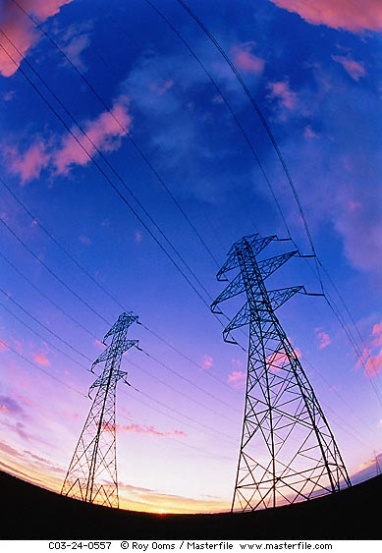
ELECTRICITY ACT 2001 MAIN FEATURES
Replaced all the previous three Electricity Laws:
Indian Electricity Act 1910, Electricity Supply Act 1948
Electricity Regulatory Commission Act 1998 as amended from time to time
2. 100% metering is mandatory for 11 KV feeder
3. 100% Rural Electrification
Accelerated Rural electrification Program, AREP)
PRIs & NGOs can be participated)
80,000 villages yet to be electrified

Slide 49
ELECTRICITY ACT 2001(Contd..)
4. Private sector Investments is allowed in Renewable Energy Sources (Generation, Distribution, Supply area)
No license is required for generation and distribution of power in Rural areas.
5. Participation in power transmission sector
6. More stringent provision for theft of electricity

Slide 50
ELECTRICITY ACT 2001(Contd..)
7. Delicensed for Captive power generation, Thermal power generation, Hydro power generation.
Can be sold directly to other consumers by wheeling through the grid under open access
Banking facility is provided to captive power plants
8. State Electricity Regulatory Commission is mandatory for all States.

